Slide 1
Types of testing
K.K.Pavithra Subashini

Slide 2
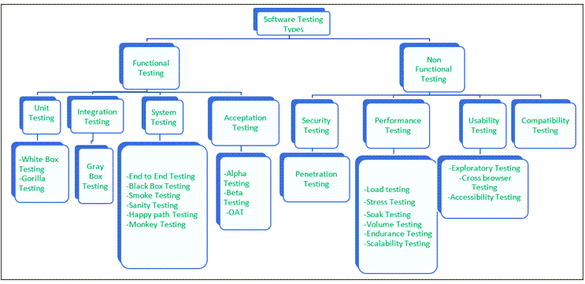
Types of testing

Slide 3
Functional Testing 1) Unit Testing
Unit testing is a type of software testing which is done on an individual unit or component to test its corrections.
Unit testing is done by the developer at the application development phase.
Developers often use test automation tools such as NUnit, Xunit, JUnit for the test execution.
Unit testing is important because we can find more defects at the unit test level.

Slide 4
a) White Box Testing
White box testing is a test technique in which the internal structure or code of an application is visible and accessible to the tester.
In this technique, it is easy to find loopholes in the design of an application or fault in business logic.
b) Gorilla Testing
Gorilla testing is a test technique in which the tester and/or developer test the module of the application thoroughly in all aspects.
Gorilla testing is done to check how robust your application is.

Slide 5
2) Integration Testing
Integration testing is a type of software testing where two or more modules of an application are logically grouped together and tested as a whole.
The focus of this type of testing is to find the defect on interface, communication, and data flow among modules.
a) Gray box testing
gray box testing is a combination of white-box testing and black-box testing.
Testers have partial knowledge of the internal structure or code of an application.

Slide 6
3) System Testing
System testing is types of testing where tester evaluates the whole system against the specified requirements.
a) End to End Testing
It involves testing a complete application environment
b) Black Box Testing
testing is performed without knowing the internal structure, design, or code of a system under test.
Testers should focus only on the input and output of test objects.

Slide 7
c) Smoke Testing
Smoke testing is performed to verify that basic and critical functionality of the system under test is working fine at a very high level.
d) Sanity Testing
Sanity testing is performed on a system to verify that newly added functionality or bug fixes are working fine.
Sanity testing is done on stable build.
It is a subset of the regression test.

Slide 8
e) Happy path Testing
The objective of Happy Path Testing is to test an application successfully on a positive flow.
It does not look for negative or error conditions.
The focus is only on valid and positive inputs through which the application generates the expected output.
f) Monkey Testing
Monkey Testing is carried out by a tester, assuming that if the monkey uses the application, then how random input and values will be entered by the Monkey without any knowledge or understanding of the application.
The objective of Monkey Testing is to check if an application or system gets crashed by providing random input values/data.

Slide 9
4) Acceptance Testing
Acceptance testing is a type of testing where client/business/customer test the software with real time business scenarios.
The client accepts the software only when all the features and functionalities work as expected.
This is the last phase of testing, after which the software goes into production.
This is also called User Acceptance Testing (UAT).

Slide 10
Non-Functional Testing
1) Security Testing
Security Testing is done to check how the software, application, or website is secure from internal and/or external threats.
This testing includes how much software is secure from malicious programs, viruses and how secure & strong the authorization and authentication processes are.
It also checks how software behaves for any hacker’s attack & malicious programs and how software is maintained for data security after such a hacker attack.

Slide 11
2) Performance Testing
Performance testing is testing of an application’s stability and response time by applying load.
Performance testing is done with the help of tools. Loader.IO, JMeter, LoadRunner, etc
a) Load testing
Load testing is testing of an application’s stability and response time by applying load, which is equal to or less than the designed number of users for an application.

Slide 12
b) Stress Testing
Stress testing is testing an application’s stability and response time by applying load, which is more than the designed number of users for an application.
d) Volume testing
Volume testing is testing an application’s stability and response time by transferring a large volume of data to the database. Basically, it tests the capacity of the database to handle the data.

Slide 13
e) Endurance Testing
Endurance testing is testing an application’s stability and response time by applying load continuously for a longer period to verify that the application is working fine.

Slide 14
3) Usability Testing
Usability testing is testing an application from the user’s perspective to check the look and feel and user-friendliness.
a) Exploratory testing
Exploratory Testing is informal testing performed by the testing team.
The objective of this testing is to explore the application and look for defects that exist in the application.
Testers use the knowledge of the business domain to test the application.

Slide 15
b) Cross browser testing
Cross browser testing is testing an application on different browsers, operating systems, mobile devices to see look and feel and performance.
c) Accessibility Testing
The aim of Accessibility Testing is to determine whether the software or application is accessible for disabled people or not.

Slide 16
4) Compatibility testing
Compatibility testing ensures that software can run on different configuration, different databases, different browsers, and their versions. The testing team performs compatibility testing.

Slide 17
Other Types of Testing
Ad-hoc Testing
This testing is performed on an ad-hoc basis, i.e., with no reference to the test case and also without any plan or documentation in place for this type of testing.
The objective of this testing is to find the defects and break the application by executing any flow of the application or any random functionality.

Slide 18
Browser Compatibility Testing
Browser Compatibility Testing is performed for web applications and ensures that the software can run with a combination of different browsers and operating systems.
This type of testing also validates whether a web application runs on all versions of all browsers or not.
Black Box Testing
Internal system design is not considered in this type of testing. Tests are based on the requirements and functionality.

Slide 19
Regression Testing
Regression testing is testing of unchanged features of the application to make sure that any bug fixes, adding new features, deleting, or updating existing features, are not impacting the working application.
Risk-Based Testing (RBT)
For Risk-Based Testing, the functionalities or requirements are tested based on their priority. Risk-Based Testing includes testing of highly critical functionality, which has the highest impact on business and in which the probability of failure is very high.

Slide 20
Negative Testing
Negative Testing technique is performed using incorrect data, invalid data, or input. It validates if the system throws an error of invalid input and behaves as expected.

